Slide 1

ECS 351L and 851L : Geospatial Data Science
Lecture 4: Gridded data analysis
Email: jonathan.ryan@duke.edu
Office: 3101 Grainger Hall
Office hours: Mondays and Wednesdays 15:00-16:00

Slide 2
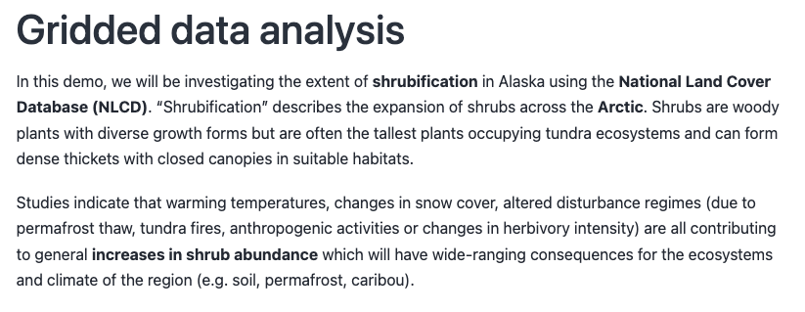
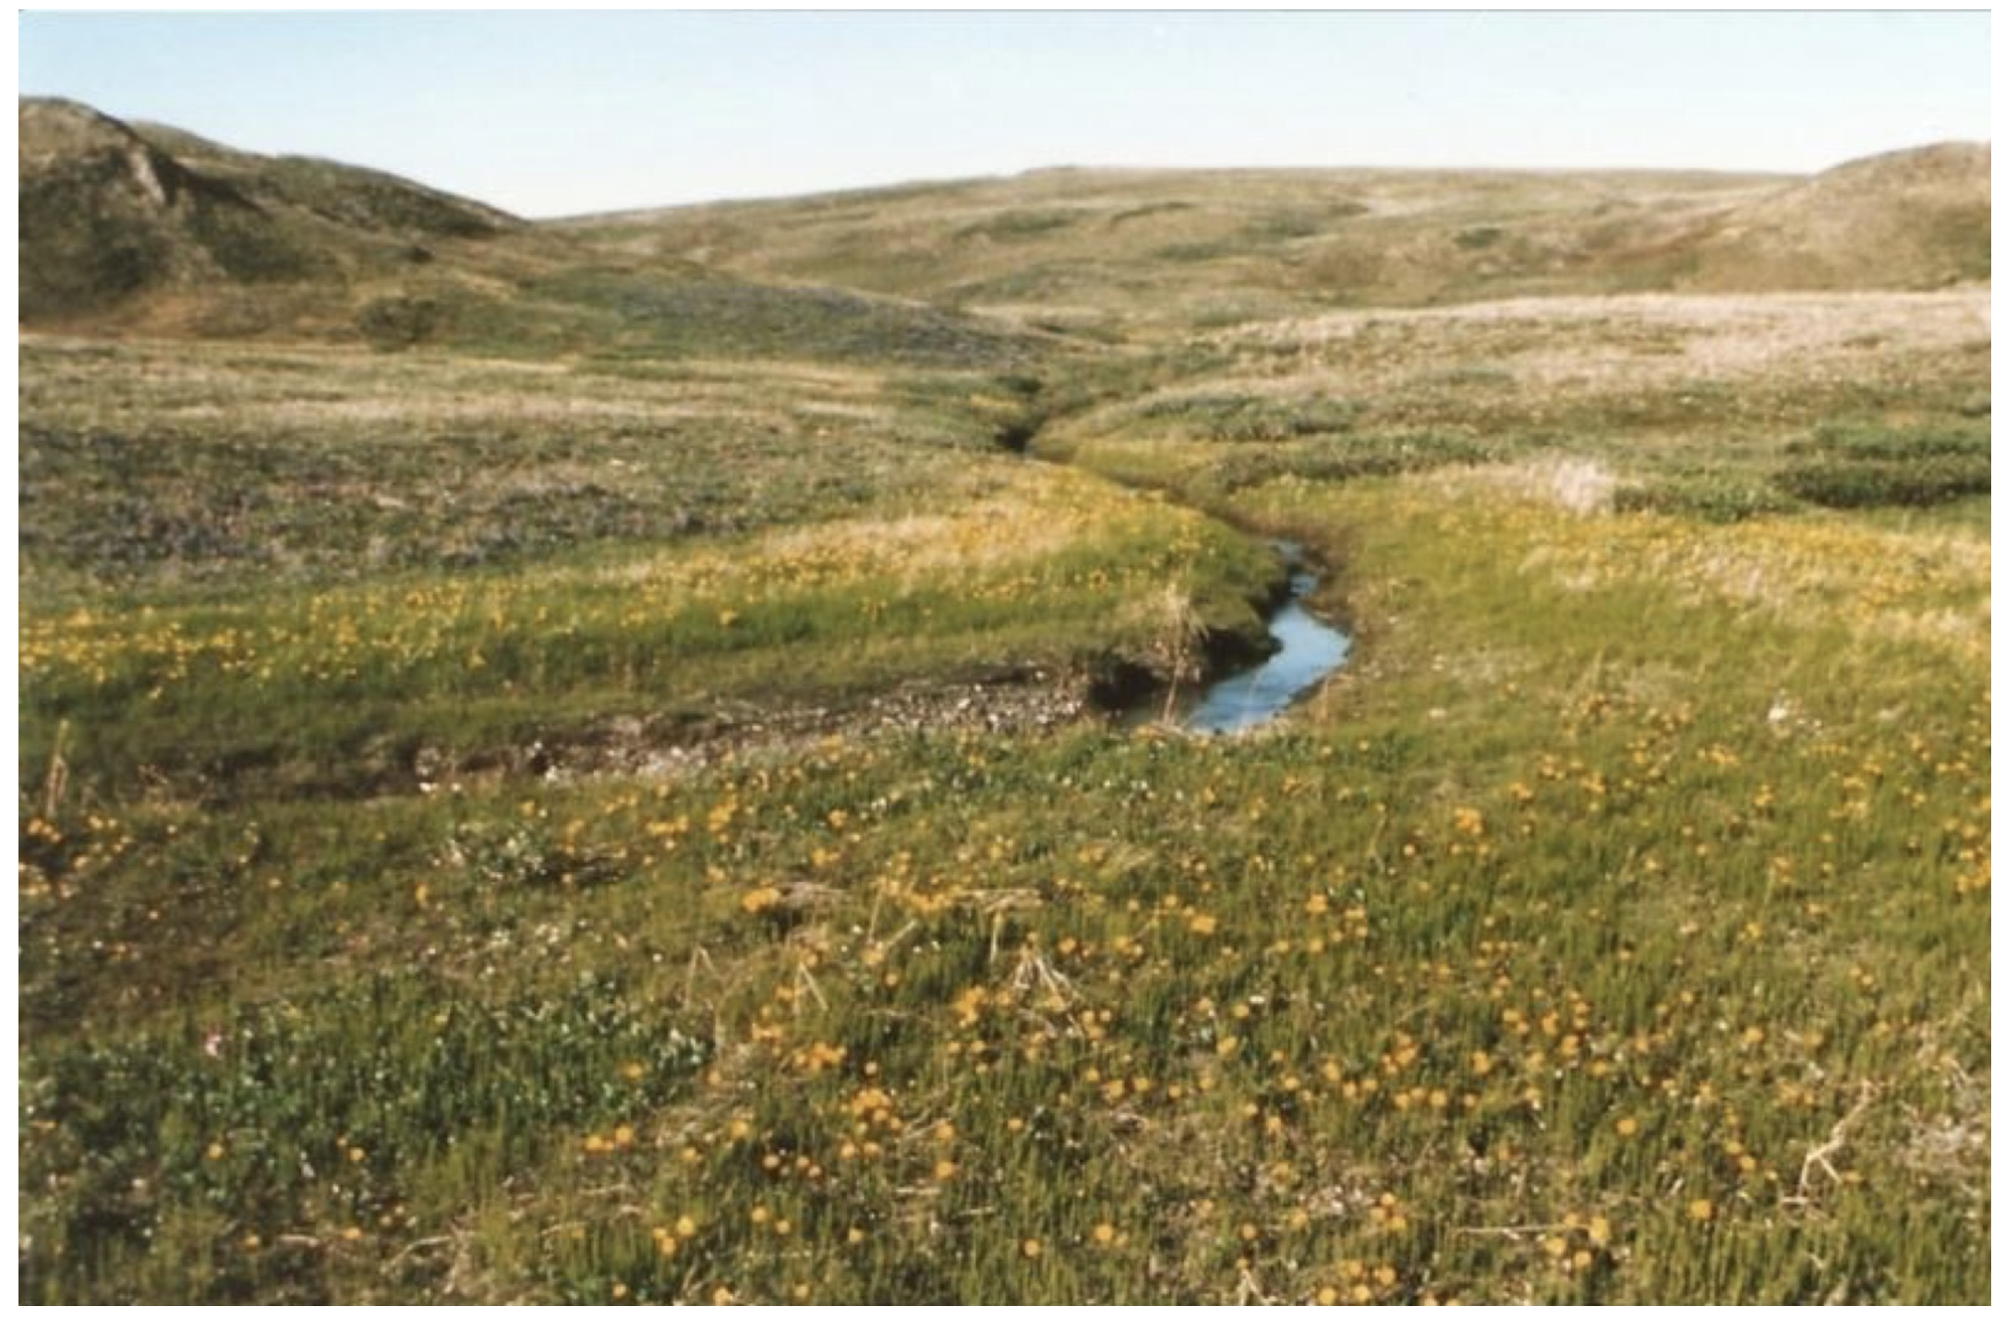
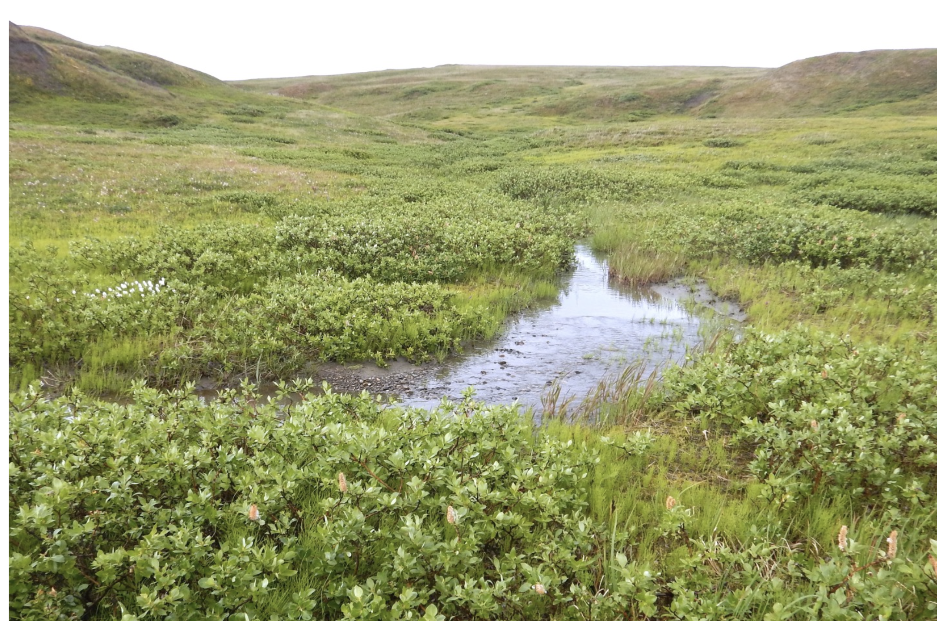
Notes:
The left photo was taken in 1987 and the right in 2017. Replacement of grasses with shrubs.

Slide 3
Notes:
Winners and losers – longer growing season might be good for birds but shrubs provide less nutrients for reindeer than grass.

Slide 4
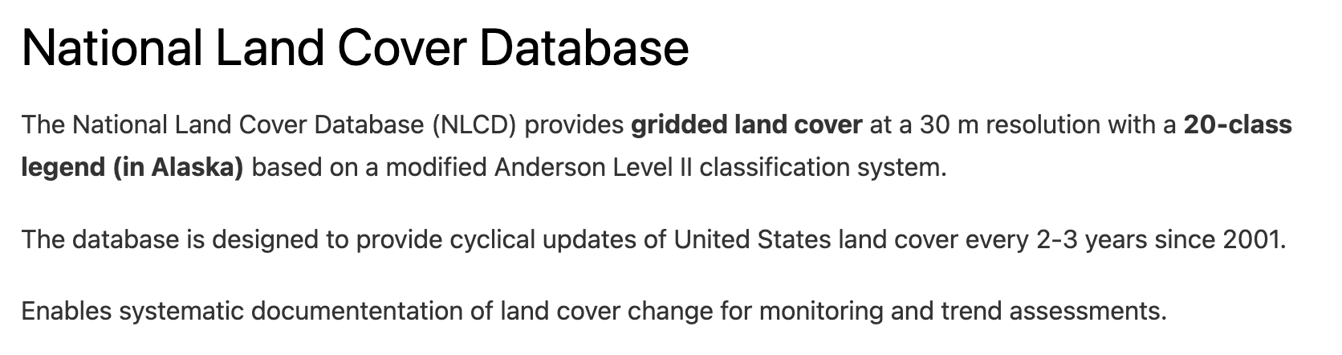
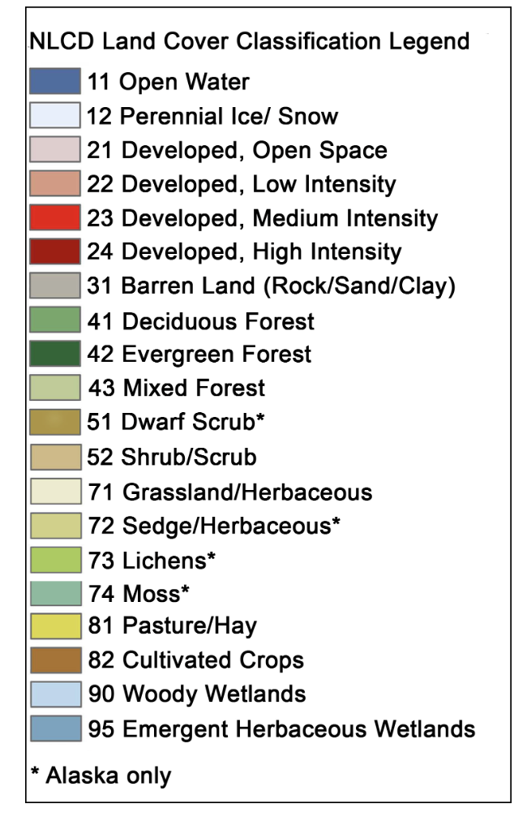
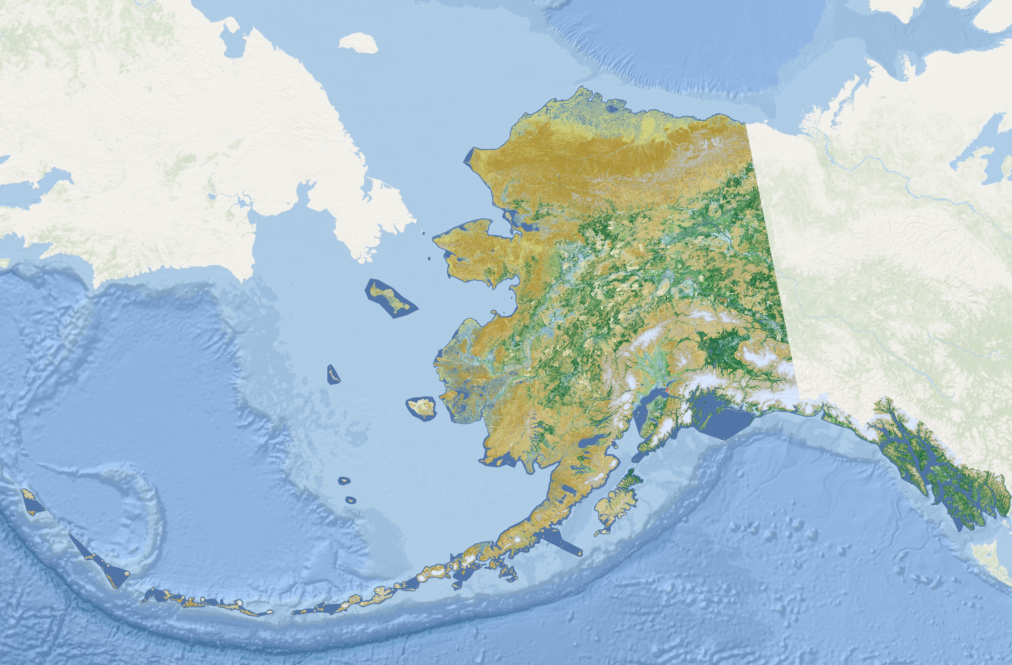

Slide 5
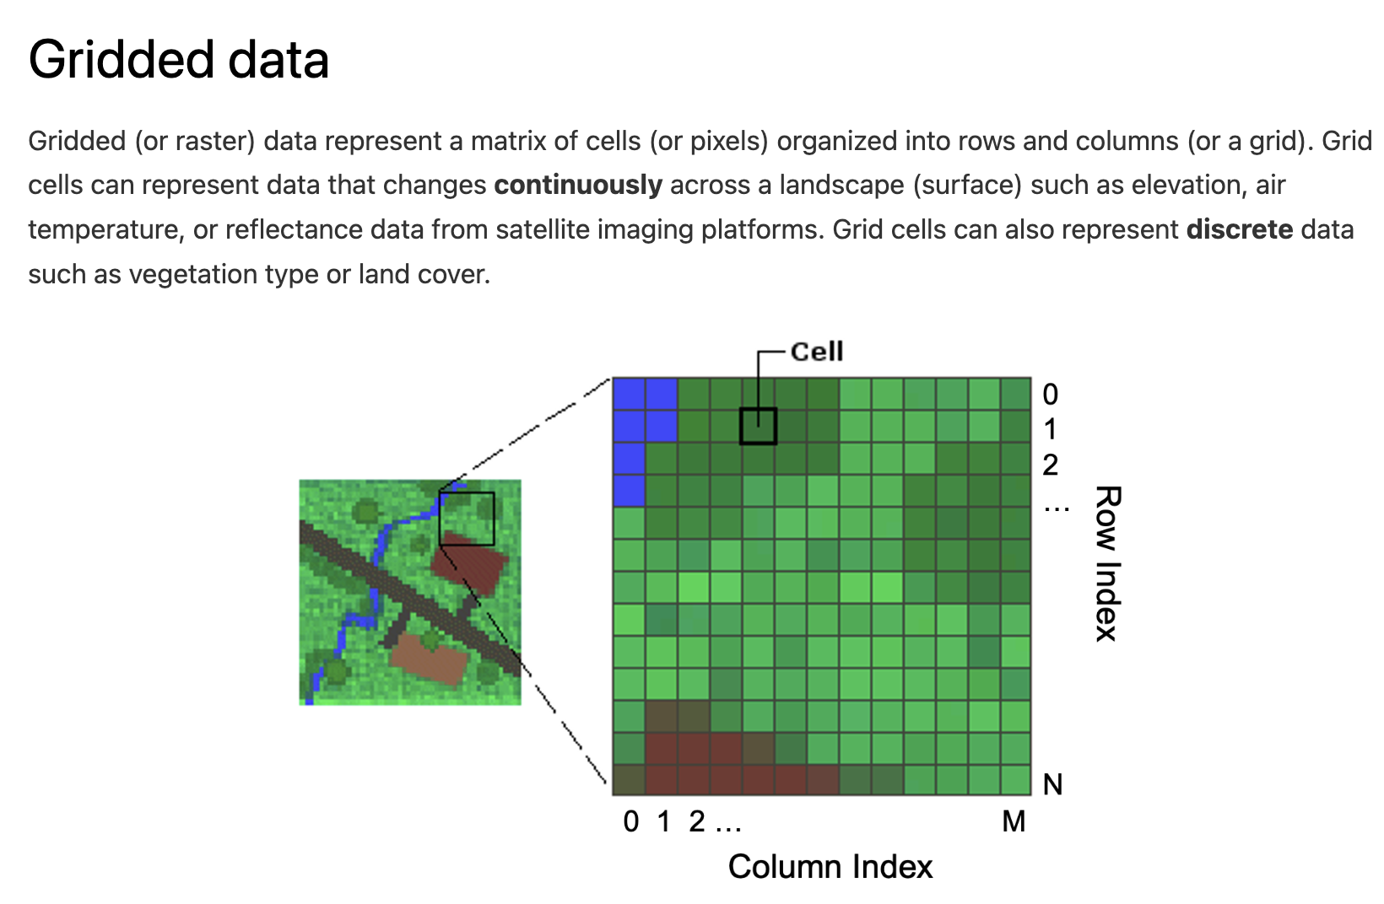

Slide 6


Slide 7
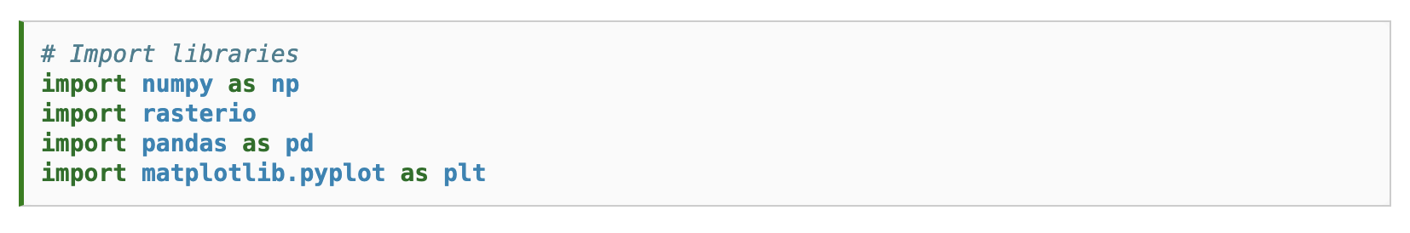

Slide 8
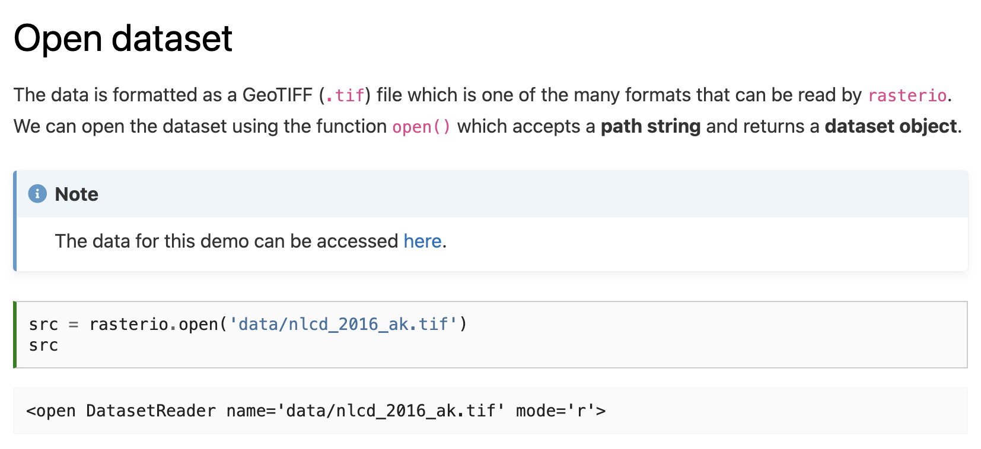

Slide 9
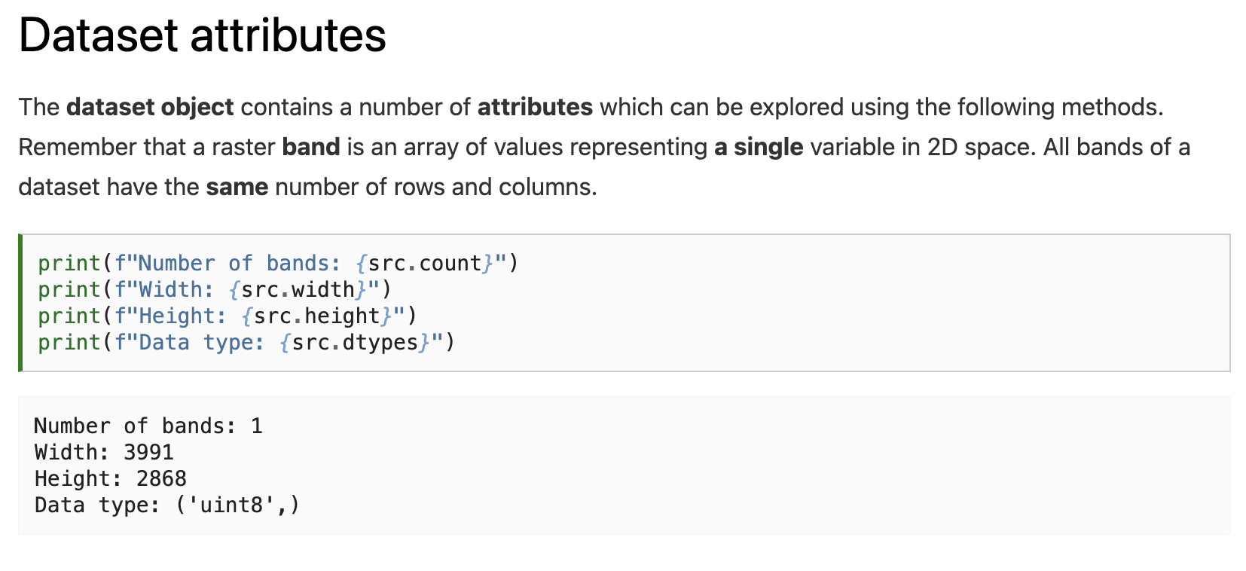
Notes:
How many different values can be stored in an uint8?

Slide 10
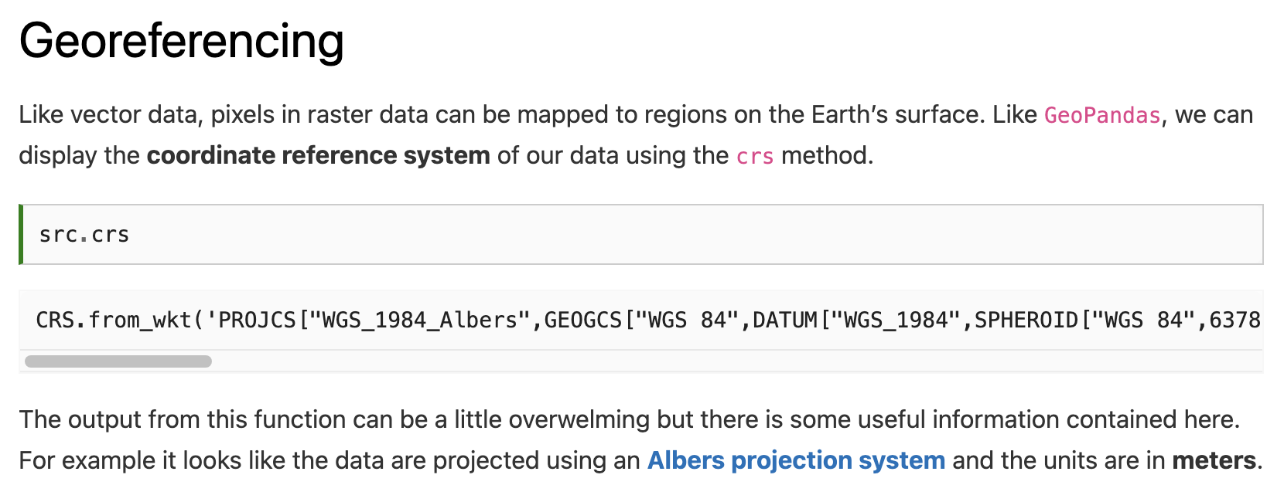

Slide 11
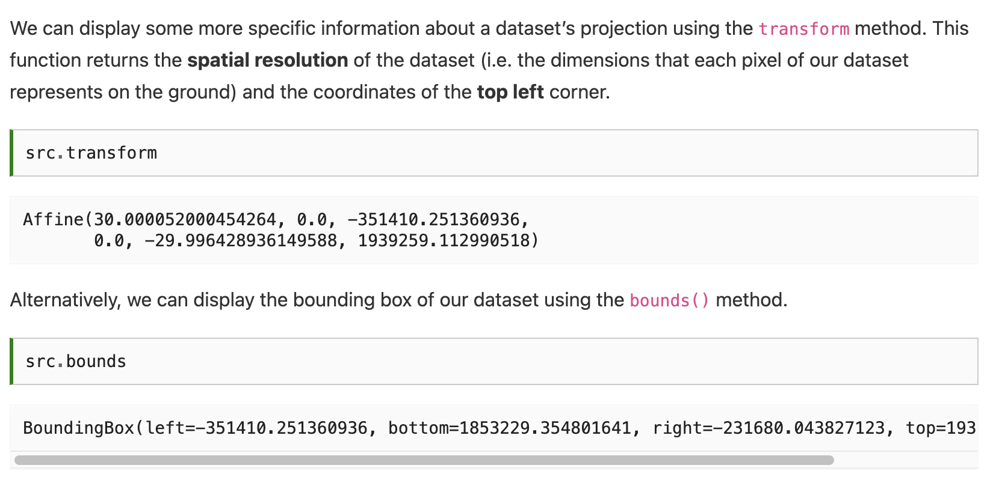

Slide 13
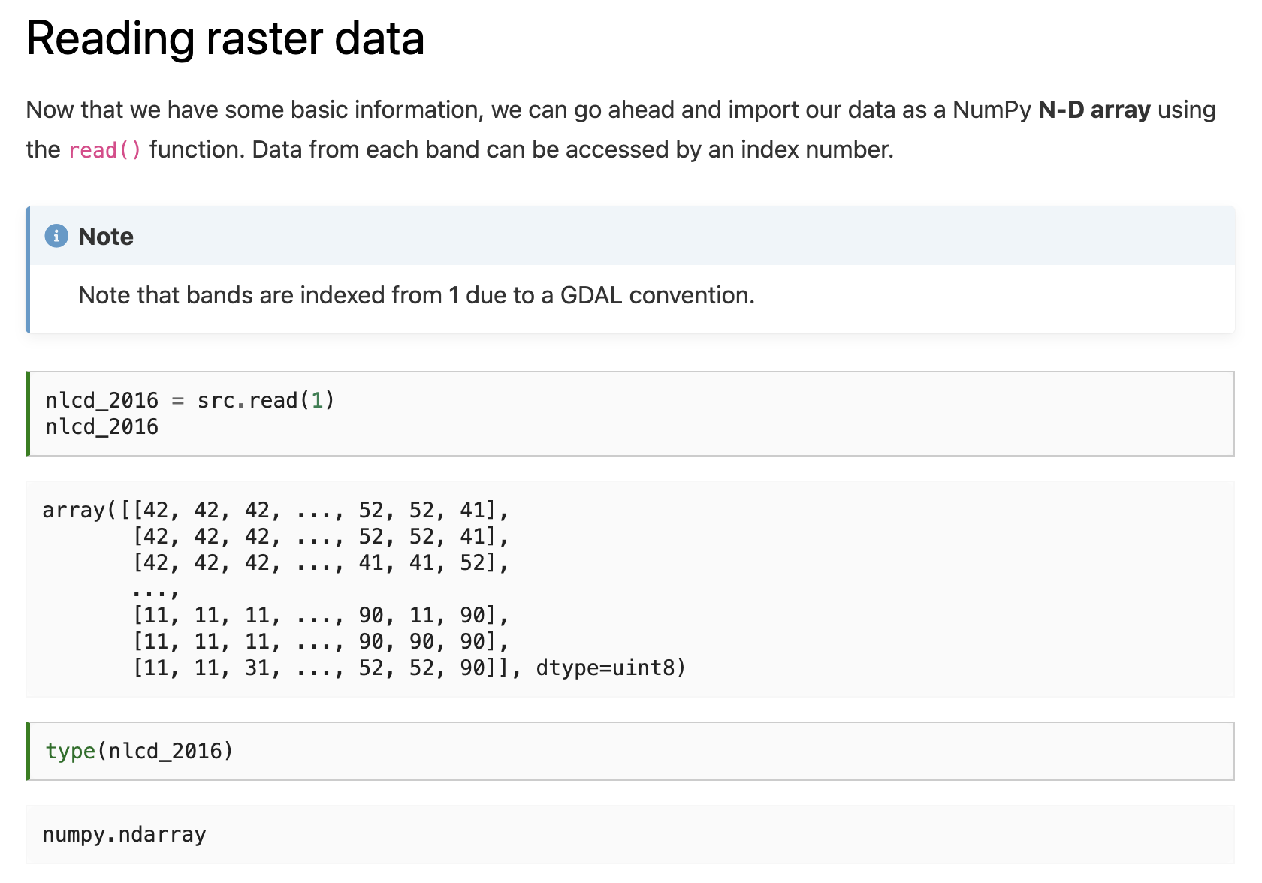

Slide 15
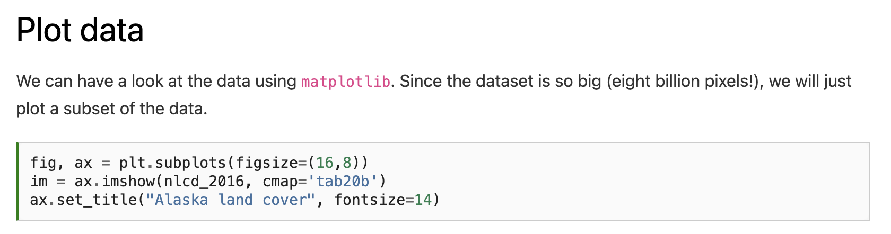
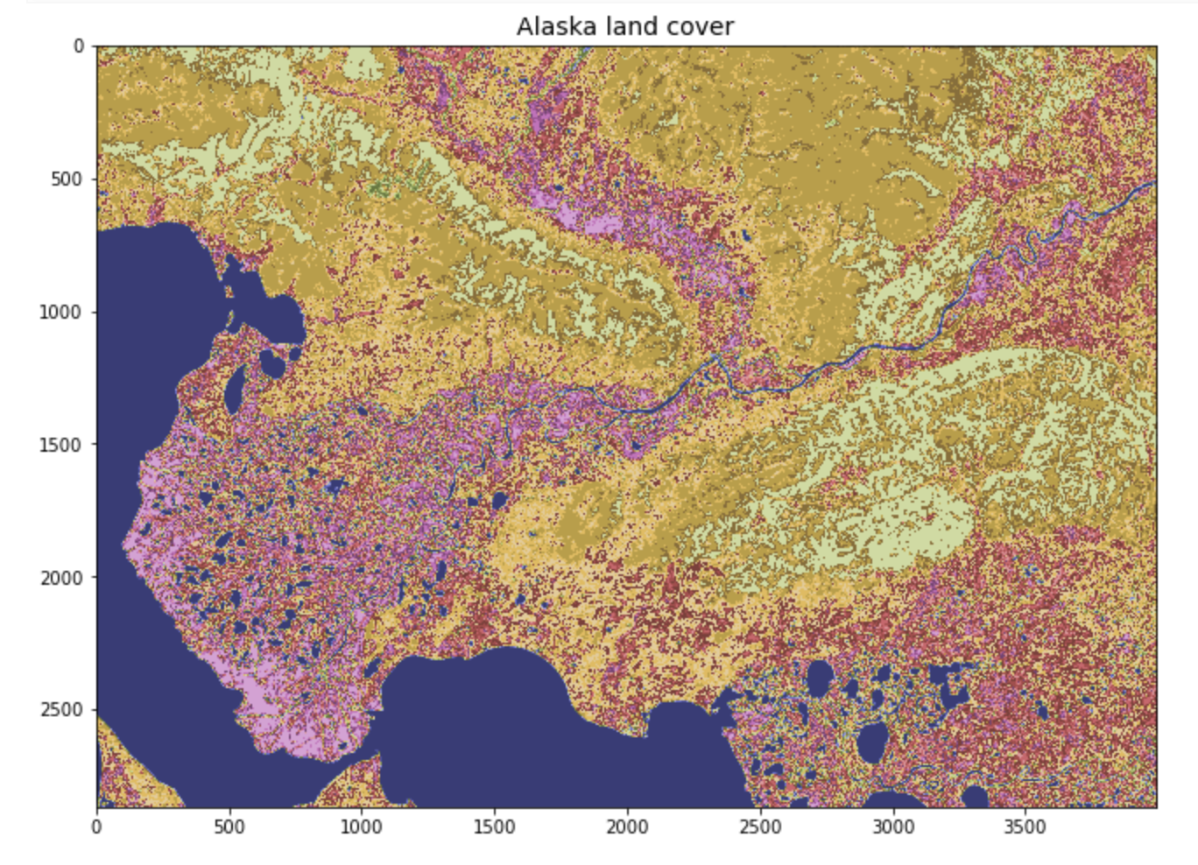

Slide 16
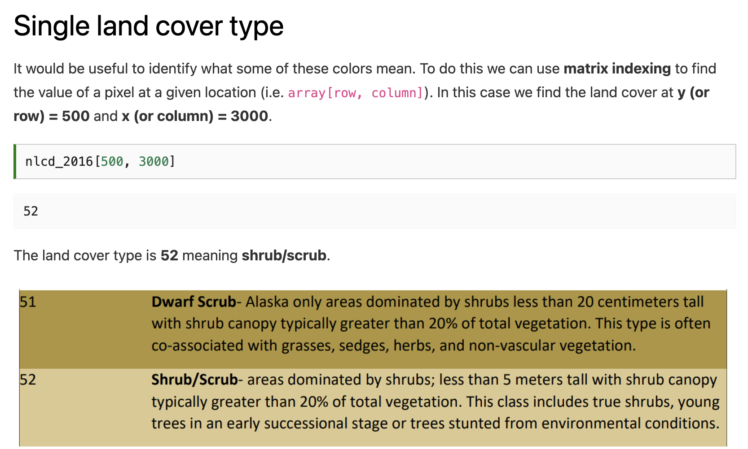

Slide 18
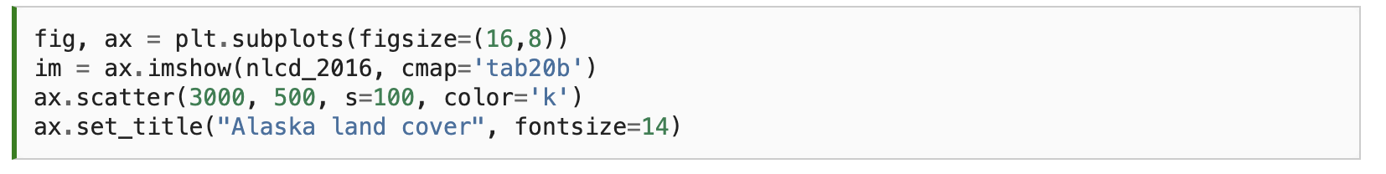
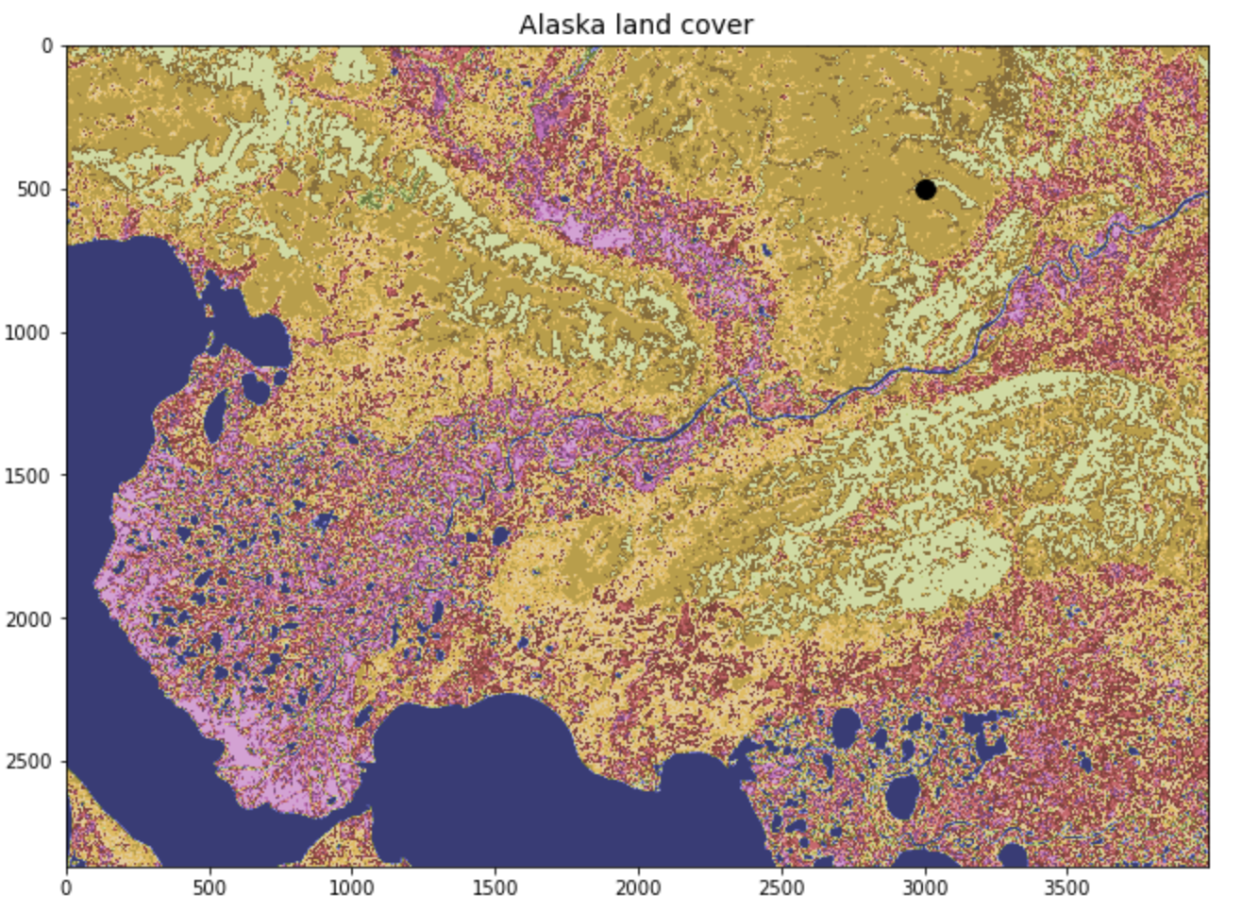

Slide 19
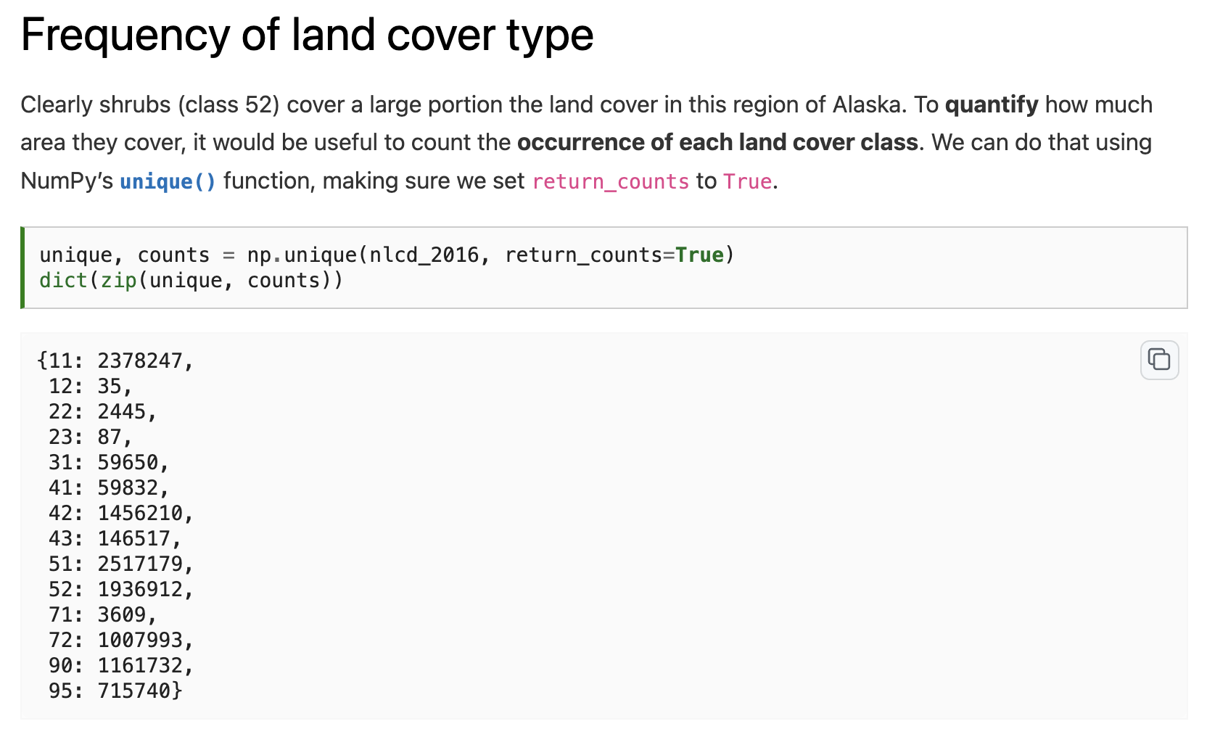

Slide 20
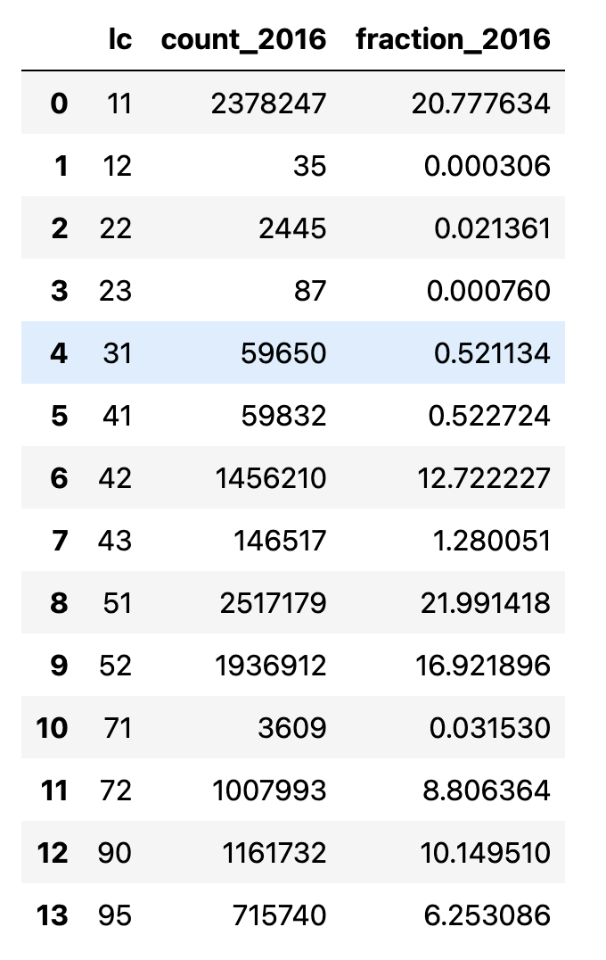
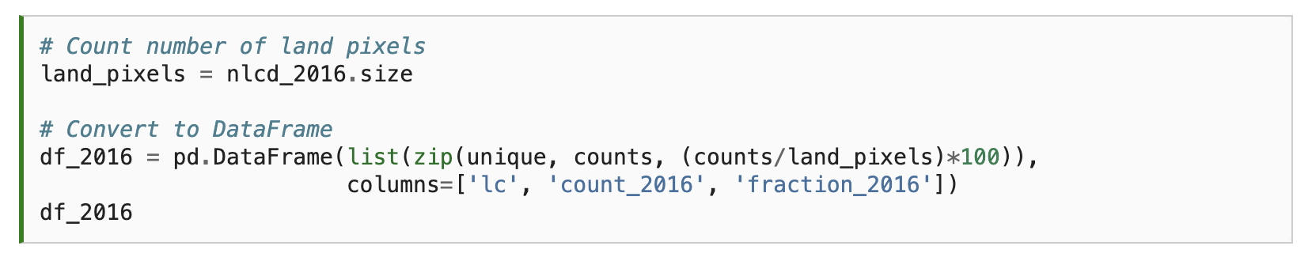
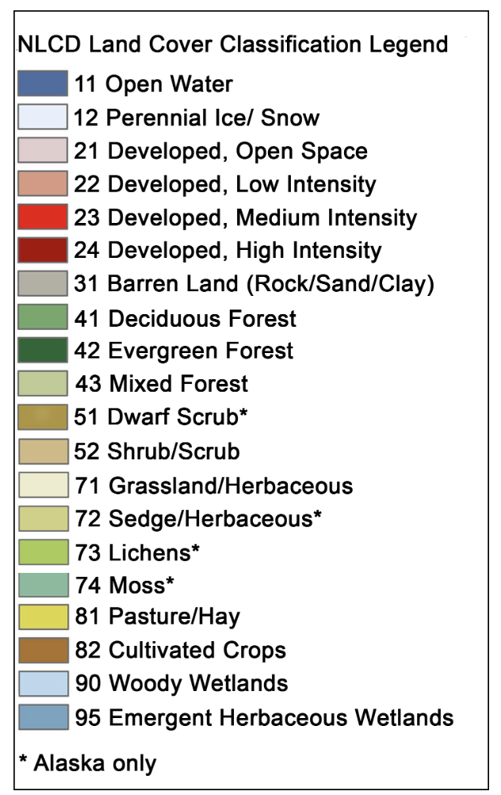

Slide 21
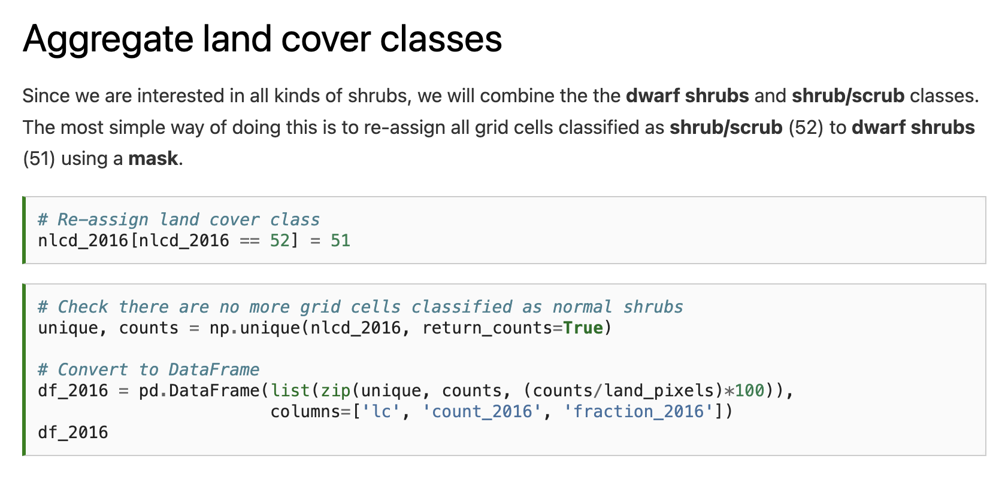

Slide 22
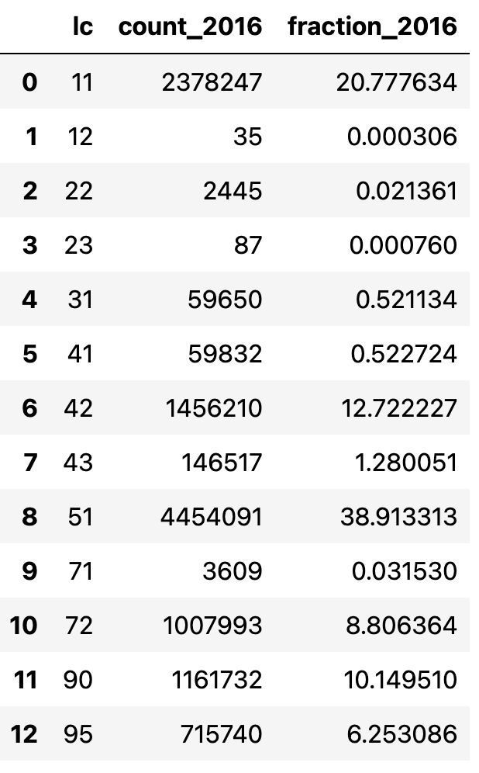

Slide 23
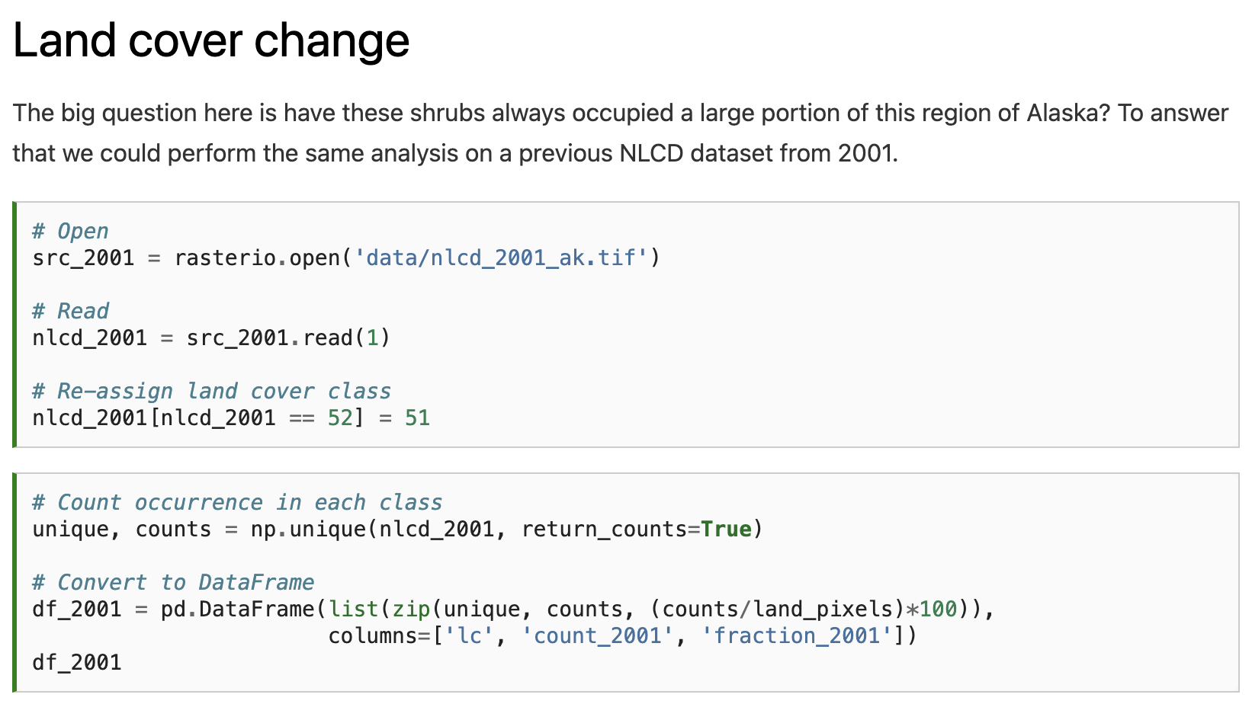
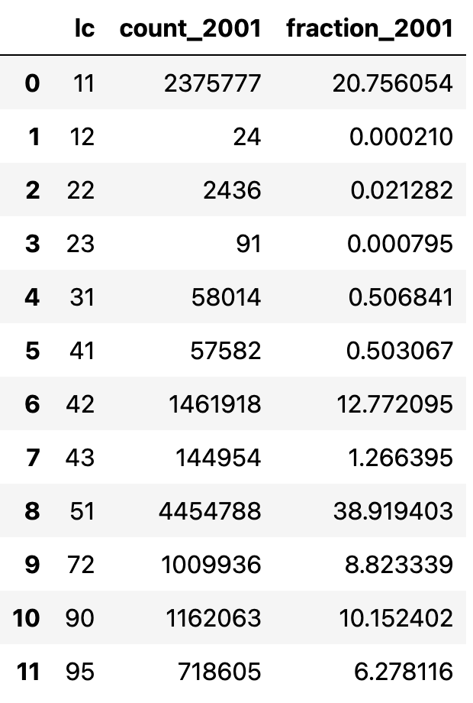

Slide 24
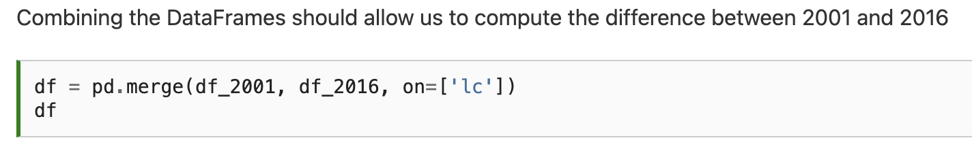
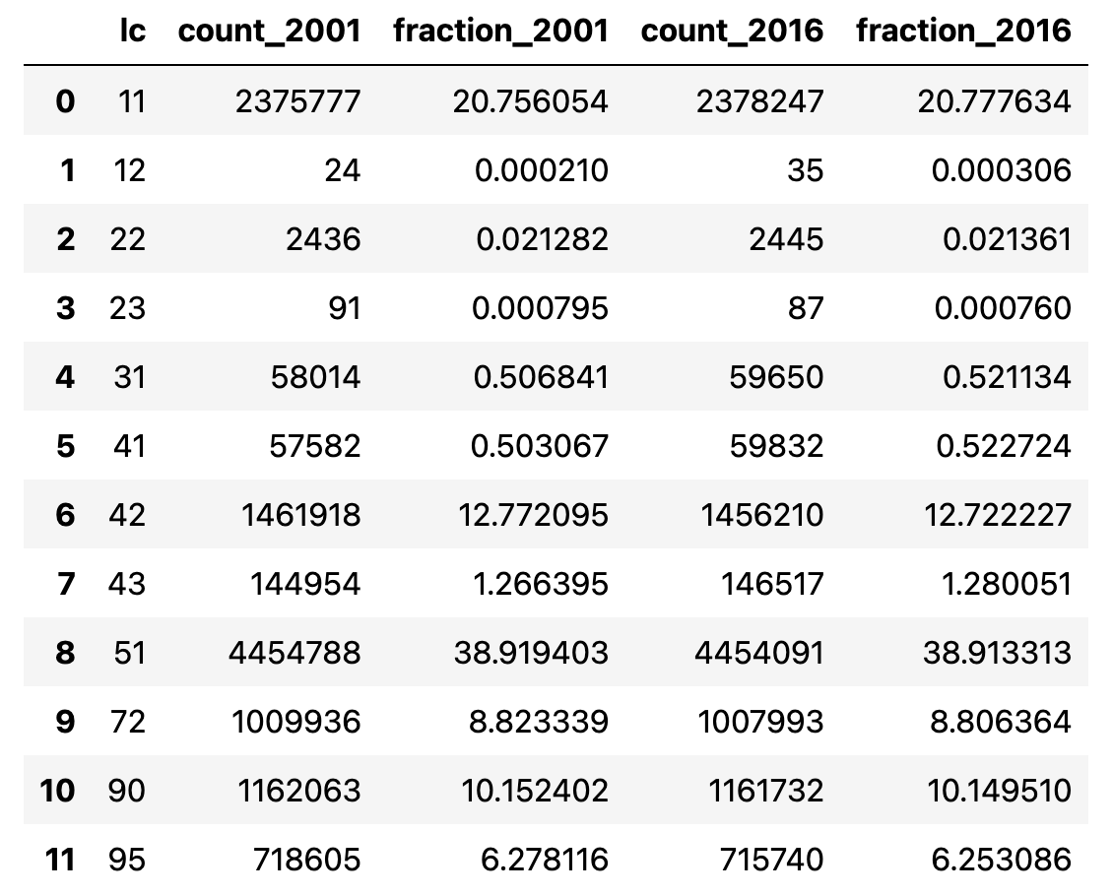

Slide 25
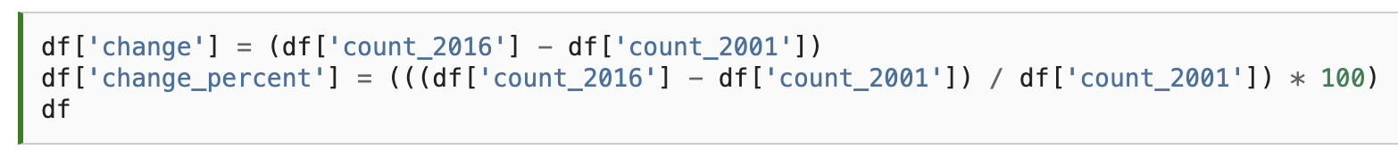

Slide 26
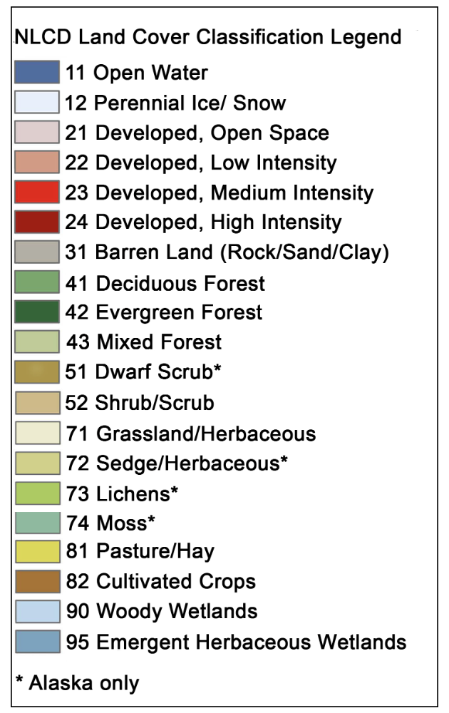
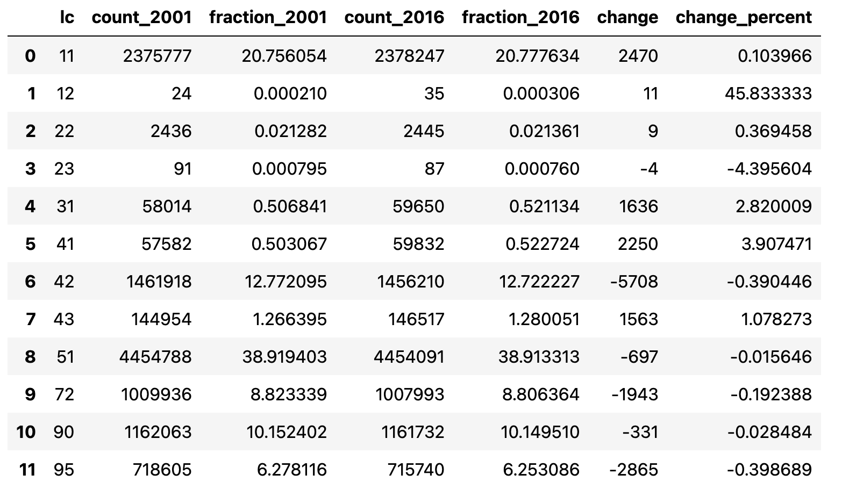
Notes:
Oh dear - the extent of shrubs did not increase between 2001 and 2016. One takeaway from this could be that shrubification is not happening in this region of the Arctic. But the percentage change in shrubs was very small (-0.02%) and could well be smaller than the uncertainty in our land cover product. For example, if just 1% of pixels were incorrectly classified as shrubs in 2001 our result would be insignificant. Other, perhaps more significant changes, that occurred between 2001 and 2016 include an increase in deciduous forest (41) by 3.9%, a decrease in evergreen forest (42) by 0.4%, and a decrease in emergent herbaceous wetlands (95) by 0.4%.

Slide 27
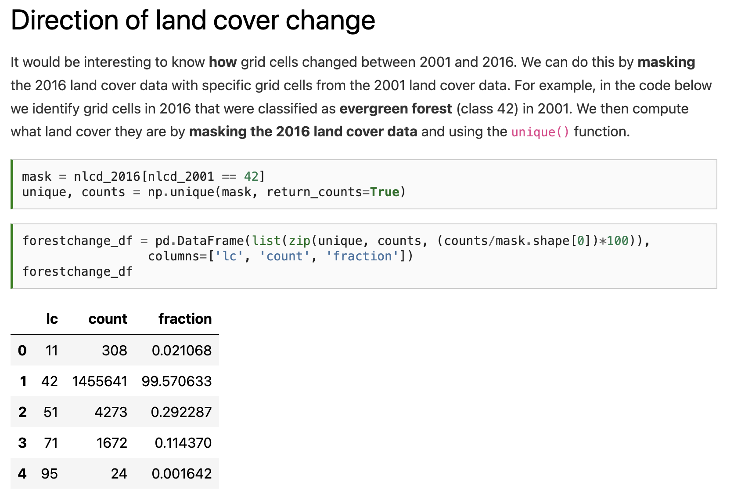

Slide 29
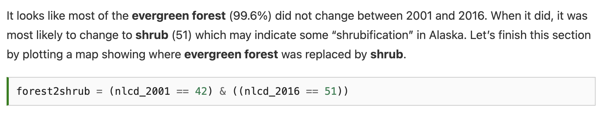

Slide 30
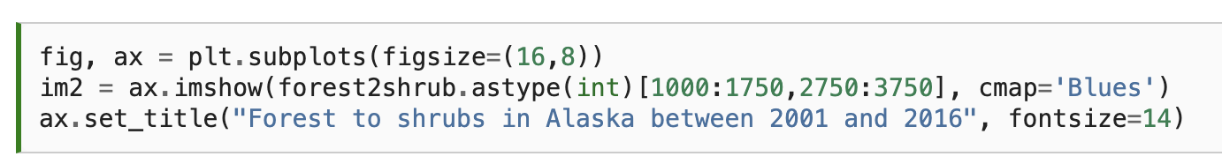
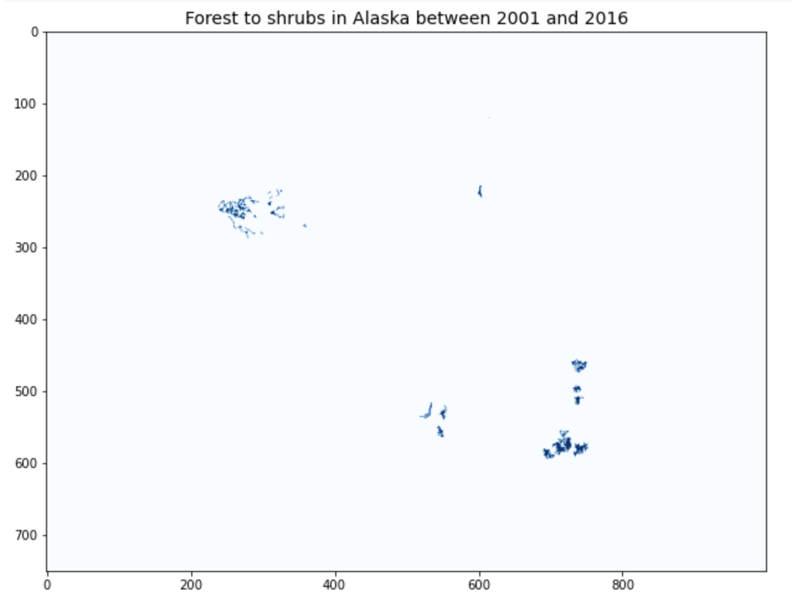

Slide 31
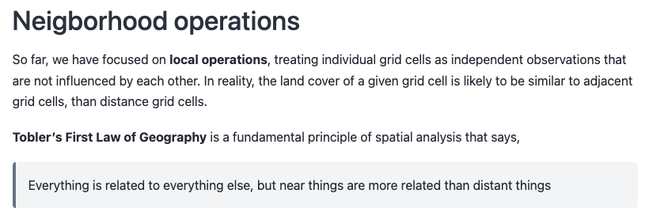

Slide 32
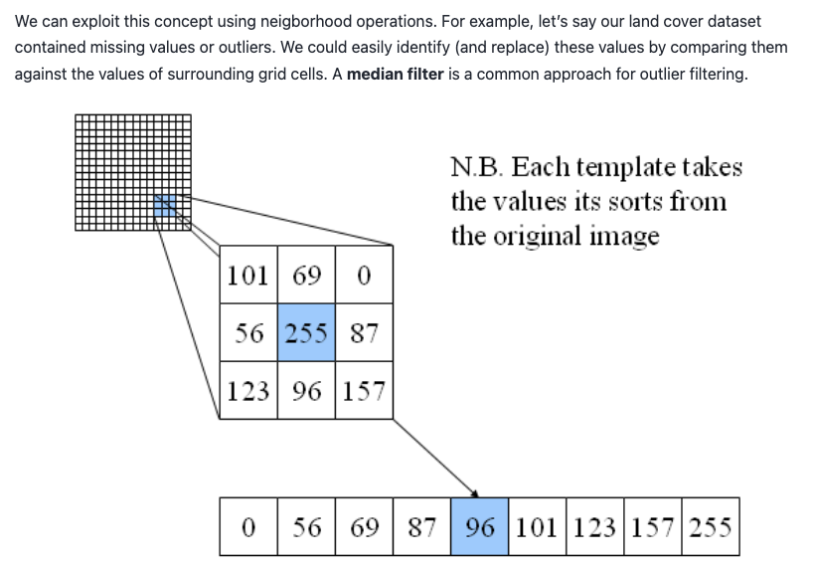

Slide 33
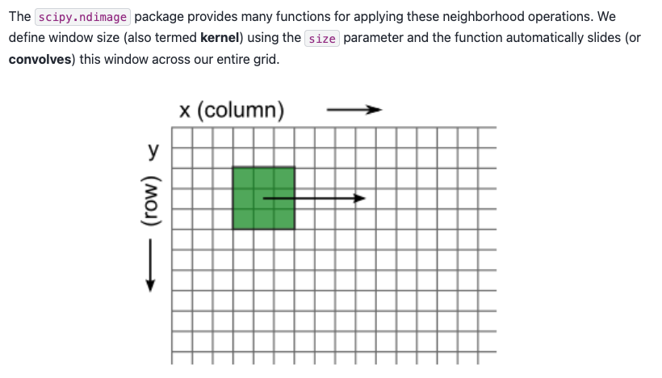

Slide 34
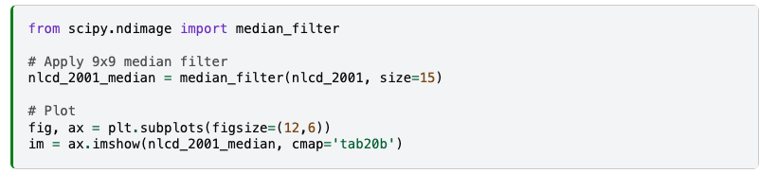
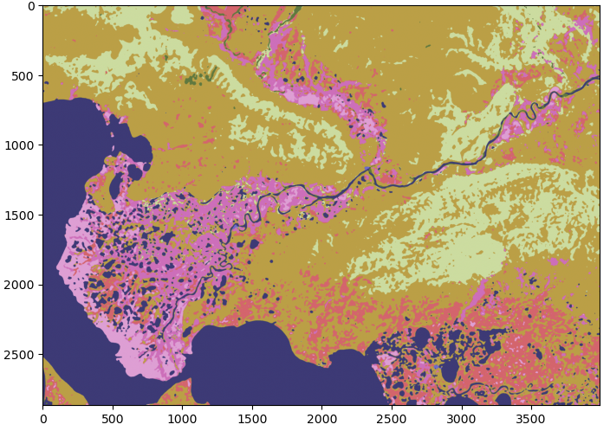

Slide 35
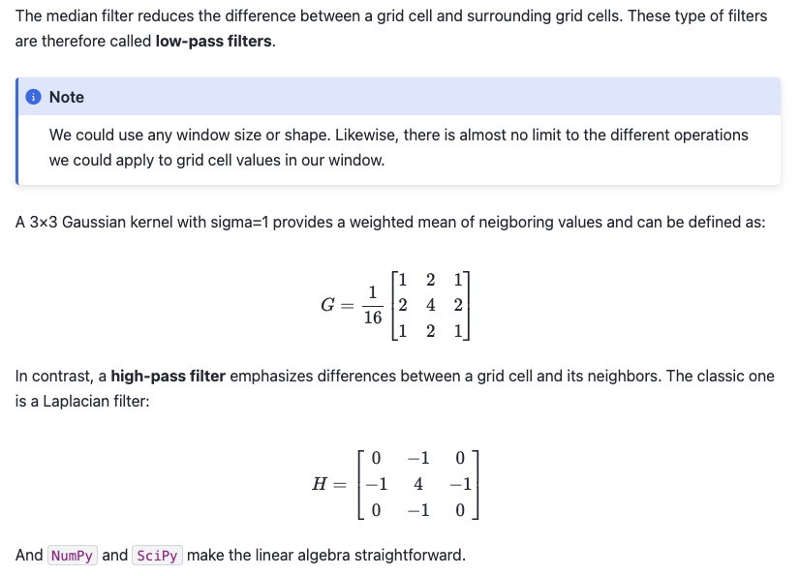

Slide 38
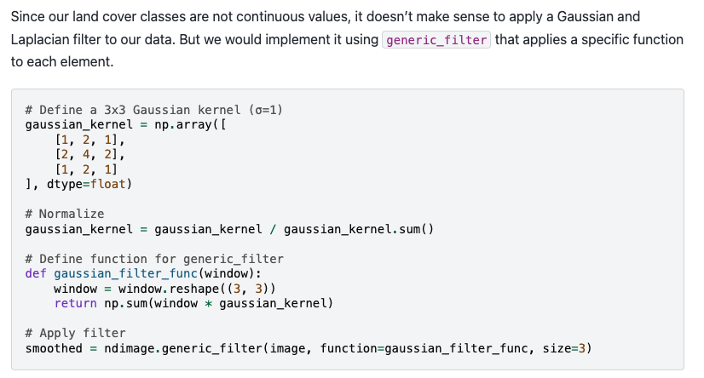

Slide 39
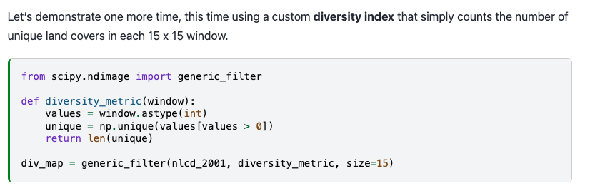

Slide 40
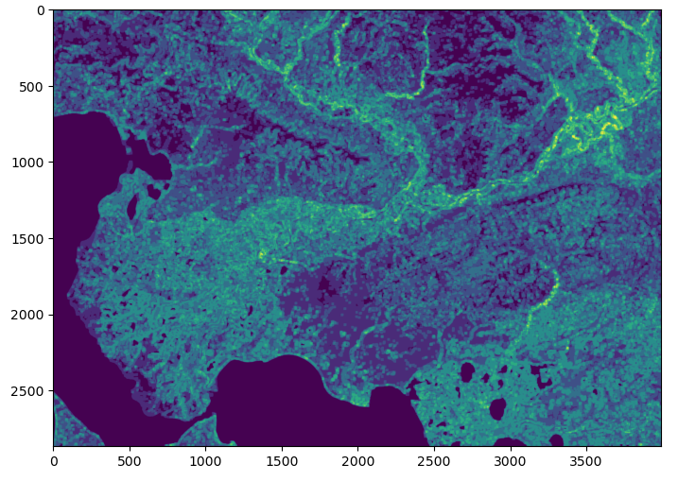

Slide 41
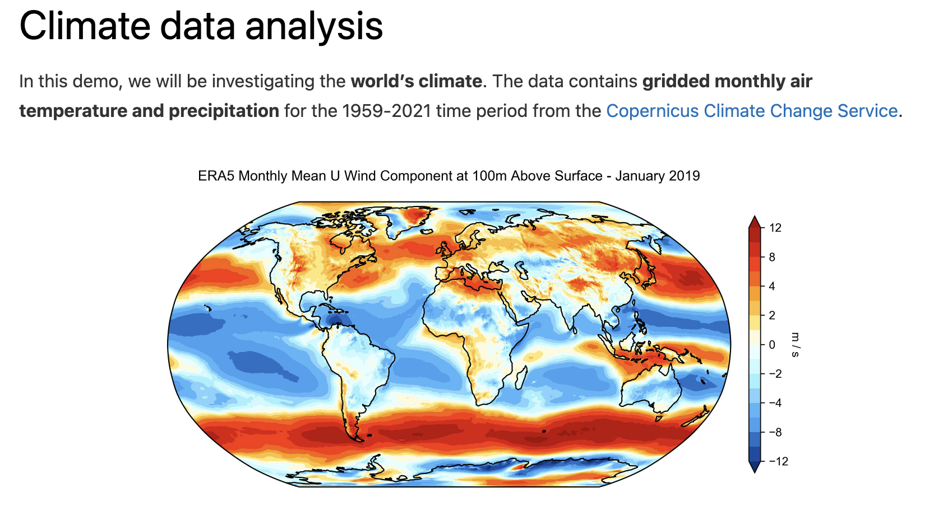

Slide 42
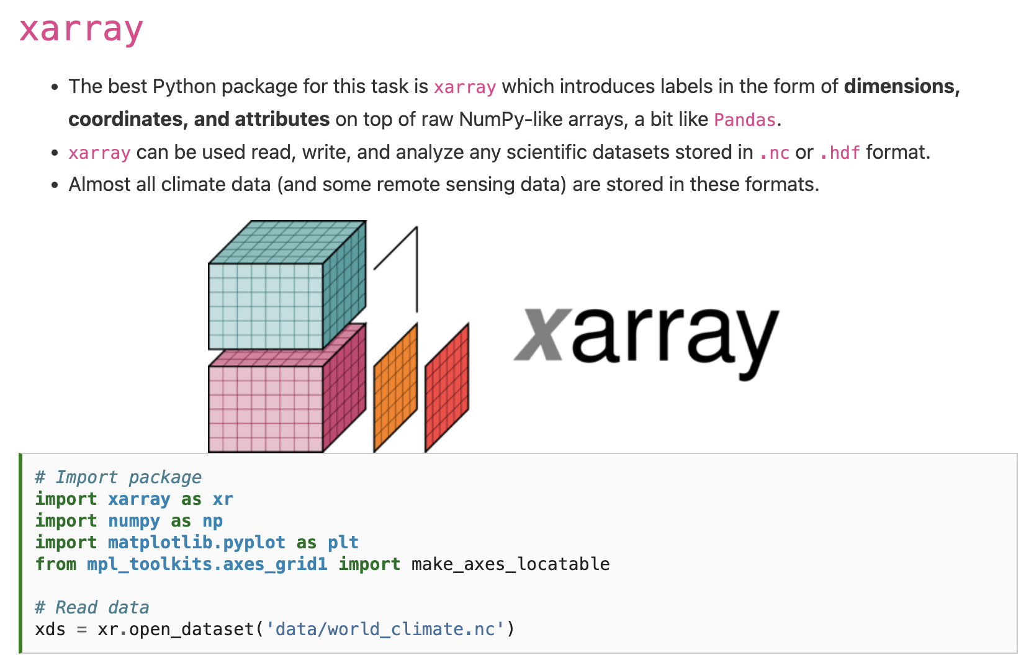

Slide 44
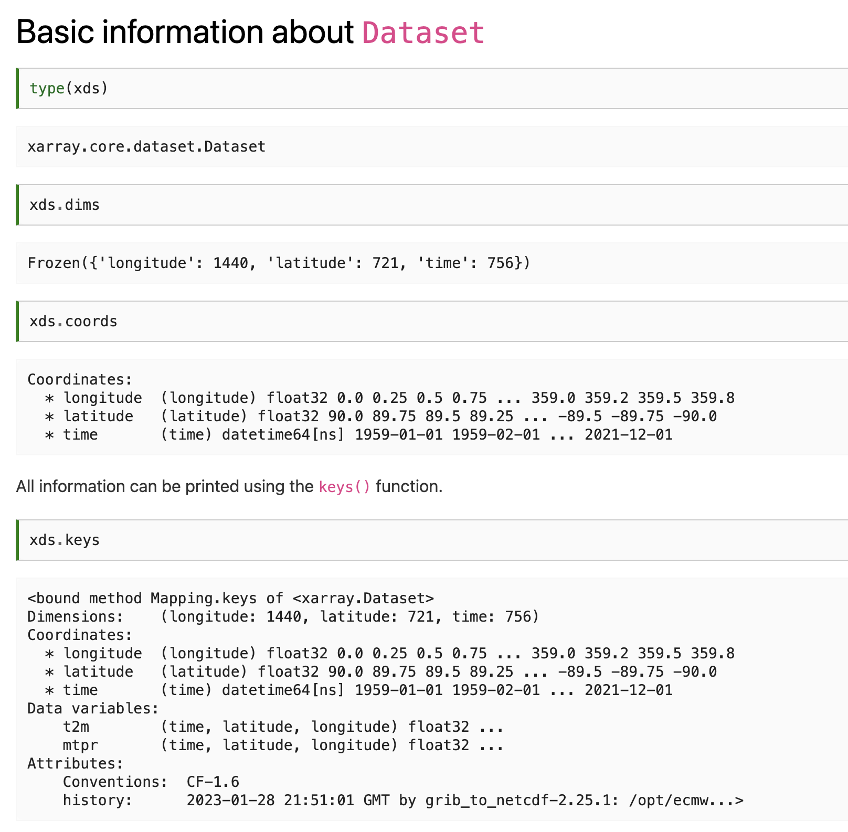

Slide 47
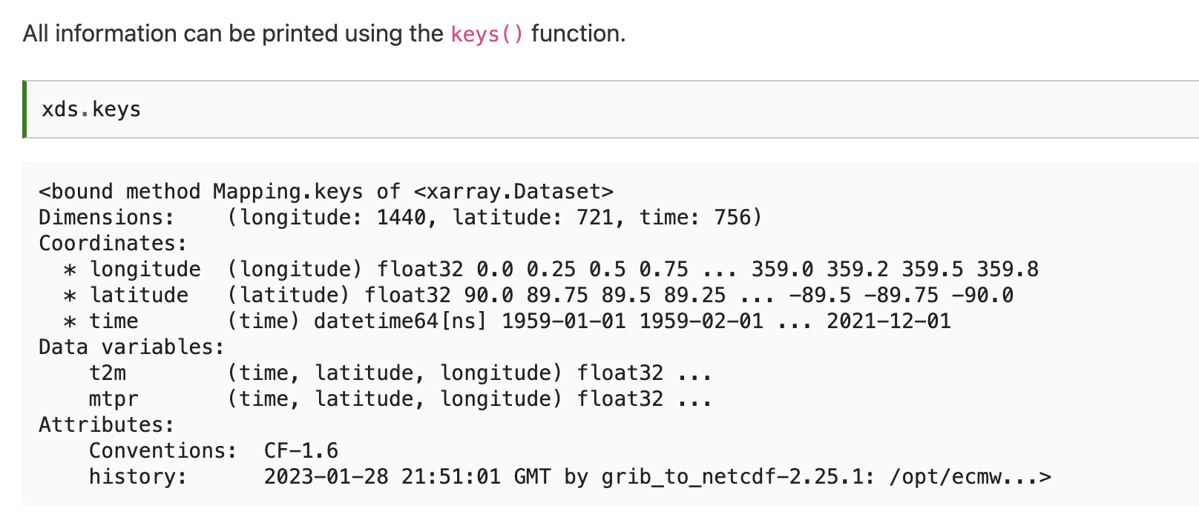
Notes:
t2m stands for 2 m above the surface, the standard height used by temperature sensors. It is a common metric used in climatology but note that it is different from the surface temperature which would be the temperature of the ground surface.

Slide 48
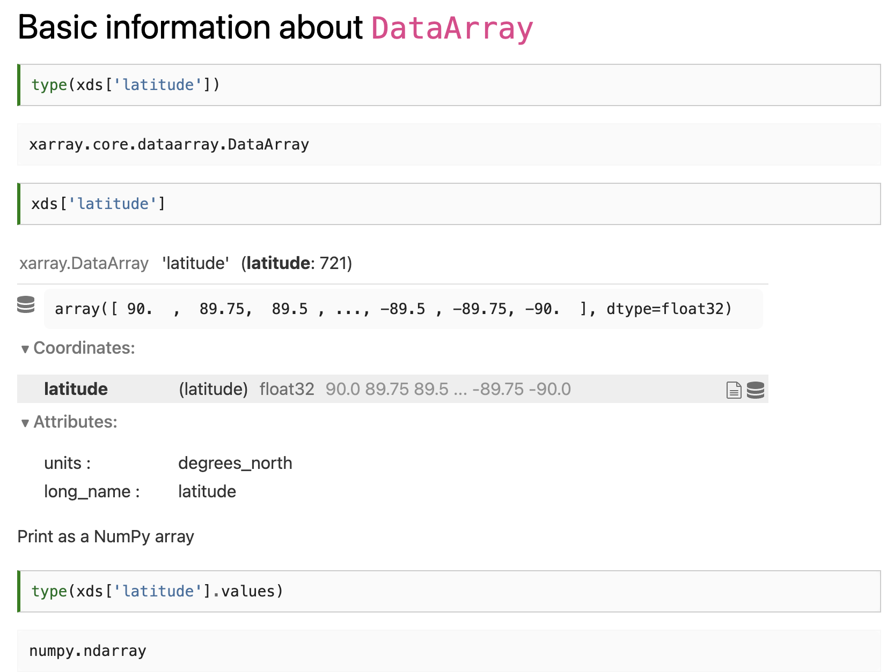
Notes:
\

Slide 49
Notes:
\

Slide 50
Notes:
\

Slide 51
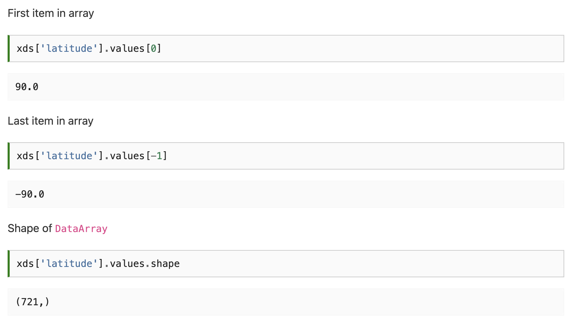
Notes:
\

Slide 52
Notes:
\

Slide 53
Notes:
\

Slide 54

Notes:
\

Slide 55
Notes:
\

Slide 56
Notes:
\

Slide 57
Notes:
\

Slide 58

Notes:
\

Slide 59

Notes:
\

Slide 60

Notes:
\

Slide 61

Notes:
\

Slide 62

Notes:
\

Slide 63

Notes:
\

Slide 64
Notes:
\

Slide 65
Notes:
\

Slide 66


Notes:
\

Slide 67

Notes:
\

Slide 68
Notes:
\

Slide 69

Notes:
\

Slide 70
Notes:
\

Slide 71

Notes:
\

Slide 72
Notes:
\

Slide 73

Wednesday: Activity
Email: jonathan.ryan@duke.edu
Office: 3101 Grainger Hall
Office hours: Mondays and Wednesdays 15:00-16:00

